Slide 1
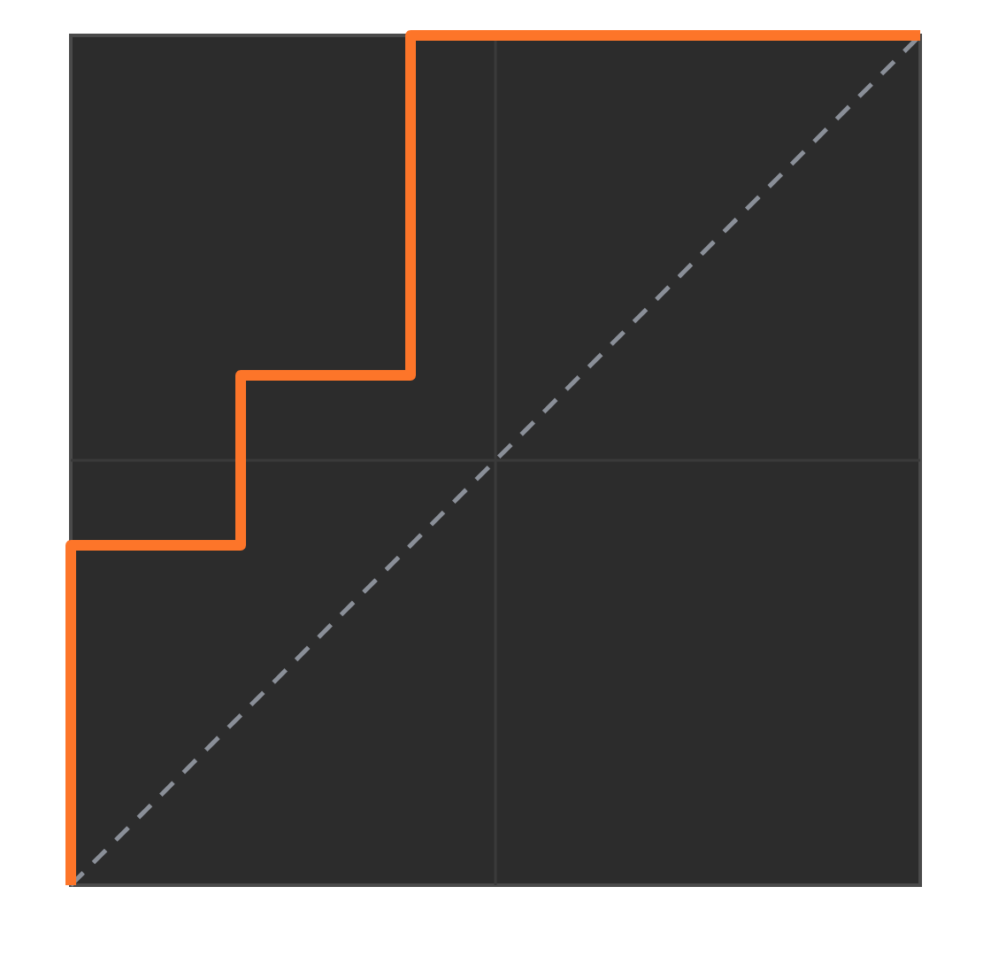
ROC curve and AUC
Practical machine learning
How well does a model tell yes from no?
Notes:
Today we answer one question: how good is a classifier at separating the two classes, for example sick from healthy patients? The ROC curve is a picture that answers it, and AUC turns that picture into a single number. We will build both from one small example of 10 patients, so every number on every slide can be checked by hand.

Slide 2
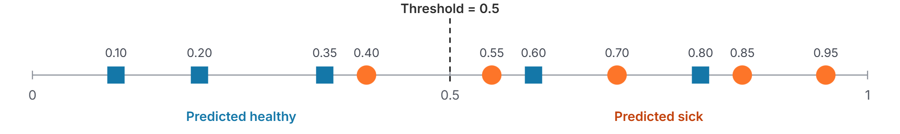
A threshold turns scores into decisions
Step 1 · Scores and a threshold
Example: a model scores 10 patients. ● = actually sick, ■ = actually healthy. A higher score means "more likely sick".
Score
Threshold
Positive and negative
The model's guess, from 0 to 1. It is not yet a yes or no.
The cut-off you choose. Score at or above it means predict sick.
Positive = the class we look for (sick). Negative = the other (healthy).
ROC and AUC · Practical machine learning
Notes:
Read the figure from left to right. Each shape is one patient placed at the score the model gave them. Orange circles are patients who really are sick, blue squares are really healthy. The dashed line is the threshold. Everyone to the right of it is predicted sick, everyone to the left is predicted healthy. Notice the model is not perfect: the healthy patient at 0.80 and 0.60 land on the sick side, and the sick patient at 0.40 lands on the healthy side. Ask the class: who is predicted wrongly at threshold 0.5? Answer: healthy 0.80 and 0.60 (false alarms) and sick 0.40 (missed).

Slide 3
Four possible outcomes at one threshold
Step 2 · Four outcomes and two rates
At threshold 0.5 | Predicted sick | Predicted healthy
Actually sick (5) | TP = 4 True positive: sick and caught | FN = 1 False negative: sick but missed
Actually healthy (5) | FP = 2 False positive: healthy but flagged (false alarm) | TN = 3 True negative: healthy and cleared
True positive rate (TPR)
TPR = TP ÷ (TP + FN) = 4 ÷ 5 = 0.8
Of the truly sick, what share did we catch? Also called recall or sensitivity. Higher is better.
False positive rate (FPR)
FPR = FP ÷ (FP + TN) = 2 ÷ 5 = 0.4
Of the truly healthy, what share did we wrongly flag? Lower is better.
ROC and AUC · Practical machine learning
Notes:
This table is called the confusion matrix. Rows are the truth, columns are the prediction. Count from the previous figure at threshold 0.5: four sick patients are on the sick side, so TP = 4, and one sick patient (0.40) is missed, so FN = 1. Two healthy patients (0.80 and 0.60) are wrongly flagged, so FP = 2, and three are correctly cleared, so TN = 3. The two rates on the right are all an ROC curve needs. TPR looks only at the sick row; FPR looks only at the healthy row. A good model has high TPR and low FPR.

Slide 4
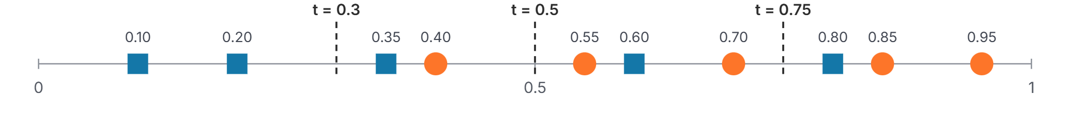
Moving the threshold changes both rates
Step 3 · Move the threshold
Threshold | Sick caught (TP) | Healthy flagged (FP) | TPR | FPR
0.75 | 2 of 5 | 1 of 5 | 0.4 | 0.2
0.5 | 4 of 5 | 2 of 5 | 0.8 | 0.4
0.3 | 5 of 5 | 3 of 5 | 1.0 | 0.6
Lower threshold: more sick caught (TPR up), but more false alarms (FPR up). Each threshold gives one (FPR, TPR) pair.
ROC and AUC · Practical machine learning
Notes:
Slide the threshold from right to left. At 0.75 the model is cautious: it flags only three patients, catching 2 of 5 sick but raising just 1 false alarm. At 0.5 it catches 4 sick and raises 2 false alarms. At 0.3 it catches every sick patient but flags 3 healthy ones. So TPR and FPR always move together: you cannot raise one without risking the other. In a cancer screening you might accept more false alarms to miss nobody; in a spam filter you might prefer fewer false alarms. The ROC curve on the next slide shows all of these choices at once.

Slide 5
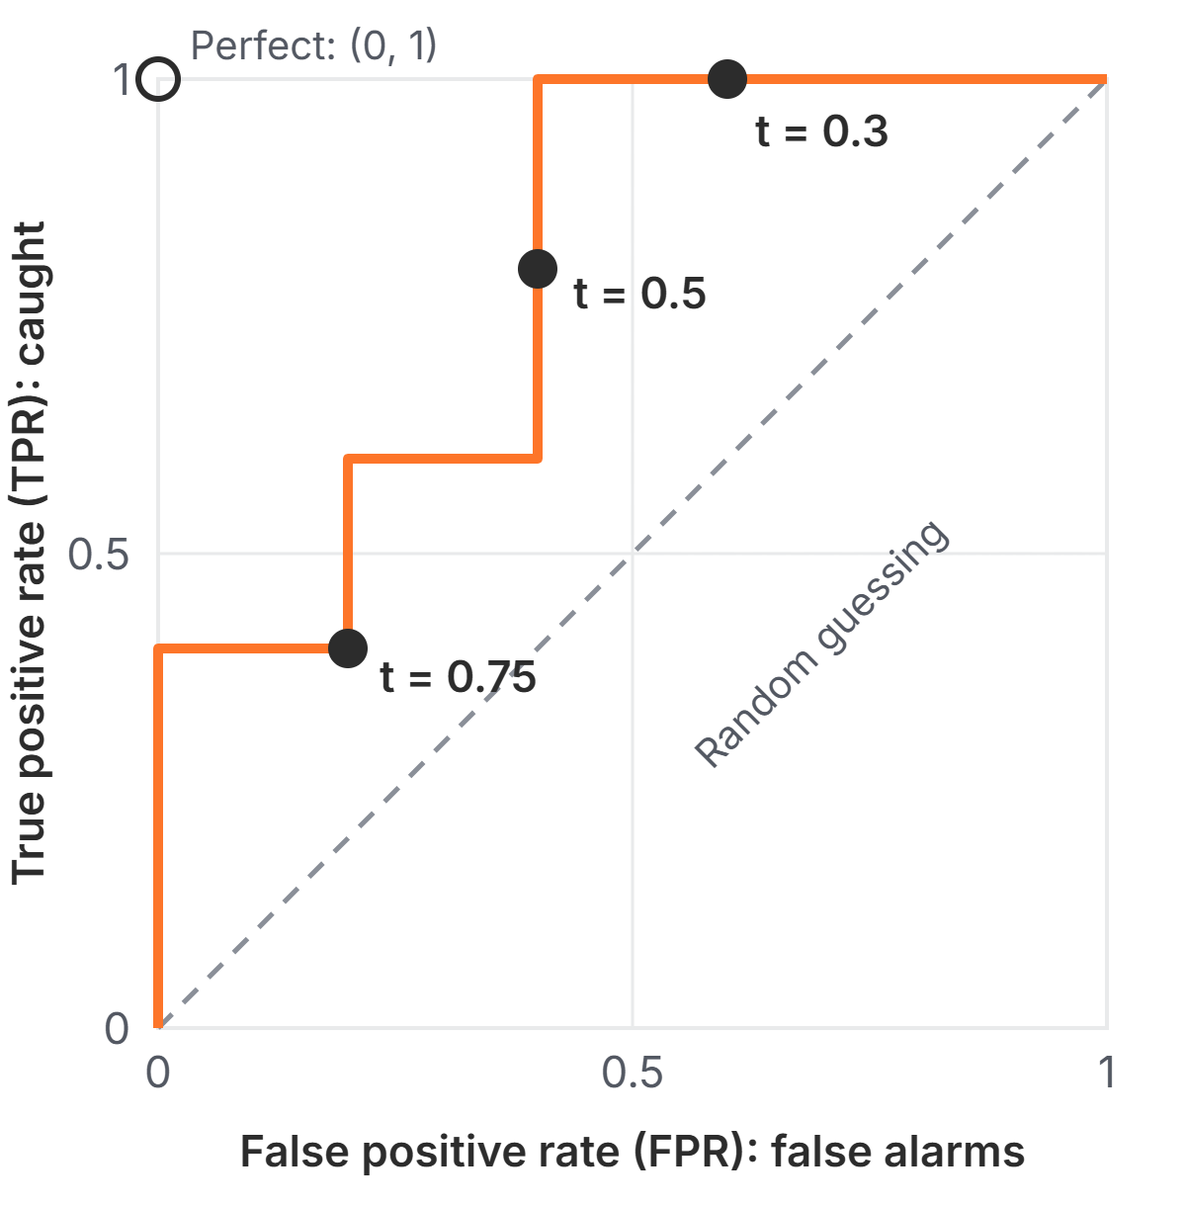
The ROC curve: one point per threshold
Step 4 · The ROC curve
Across (x-axis): FPR, the share of healthy patients falsely flagged. Further left is better.
Up (y-axis): TPR, the share of sick patients caught. Higher is better.
Each dot is one threshold from the previous slide. Joining all thresholds draws the curve.
Top-left corner = perfect: catch everyone, no false alarms. Dashed diagonal = random guessing.
ROC and AUC · Practical machine learning
Notes:
ROC stands for Receiver Operating Characteristic, a name from radar engineering; students only need to know it is a plot of TPR against FPR. Point to the three dark dots: they are exactly the three rows of the previous table, for example t = 0.5 sits at FPR 0.4, TPR 0.8. The curve starts at (0, 0), a threshold so high nobody is flagged, and ends at (1, 1), a threshold so low everybody is flagged. The closer the curve bends toward the top-left corner, the better the model separates the classes. A model that guesses randomly stays on the dashed diagonal.

Slide 6
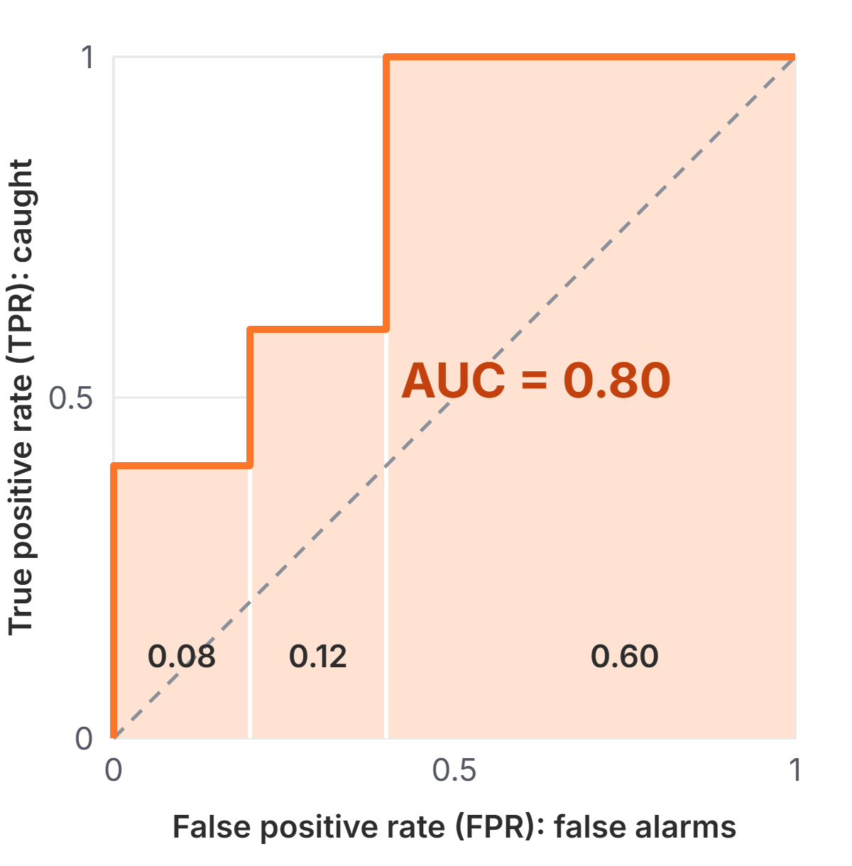
AUC is the area under the ROC curve
Step 5 · AUC
Reading the figure
The shaded area splits into three blocks: 0.08 + 0.12 + 0.60 = 0.80. The whole square has area 1.
1.0 = perfect · 0.5 = random guessing
What 0.80 means
Pick one sick and one healthy patient at random: an 80% chance the sick one gets the higher score.
Check: in 20 of the 25 sick–healthy pairs, the sick patient scores higher. 20 ÷ 25 = 0.80.
ROC and AUC · Practical machine learning
Notes:
AUC means Area Under the Curve. Because both axes run from 0 to 1, the whole square has area 1, so AUC is always between 0 and 1. Our staircase makes the area easy to compute as three rectangles: width 0.2 times height 0.4, width 0.2 times height 0.6, and width 0.6 times height 1. The more useful meaning is the ranking one: AUC is the chance that a randomly picked positive gets a higher score than a randomly picked negative. Let students verify it: list the 25 sick-healthy pairs and count the 20 where the sick patient has the higher score. The random diagonal has area 0.5, which is why 0.5 means no skill. AUC does not depend on any single threshold.

Slide 7
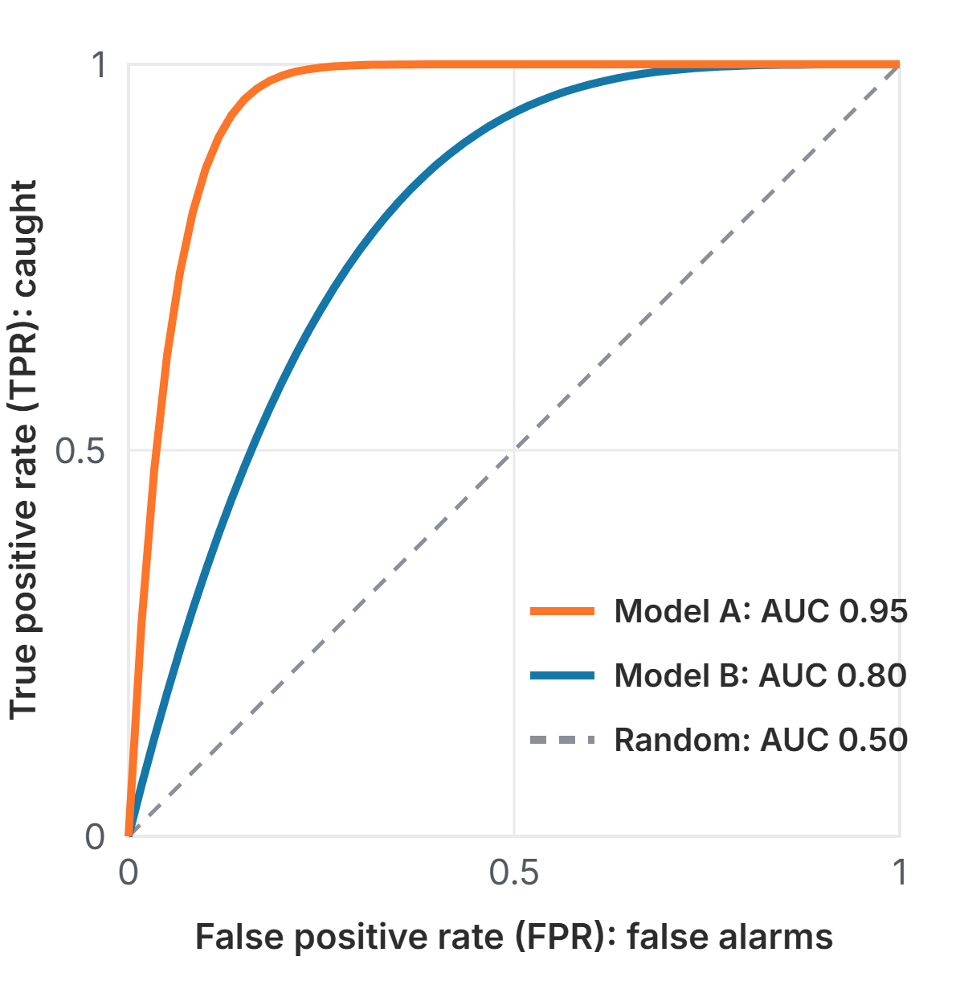
Comparing models with ROC and AUC
Using ROC and AUC
Closer to the top-left wins
Model A's curve is above Model B's everywhere, so A is better at every threshold. Its larger AUC says the same in one number.
AUC picks the model, not the threshold
After choosing a model, pick the threshold on its curve that fits the cost of each mistake.
ROC and AUC · Practical machine learning
Notes:
The figure shows illustrative curves, not real models. Model A bends sharply toward the top-left, Model B less so, and the dashed line is random guessing. When one curve is above another everywhere, that model is better at every threshold. When curves cross, AUC still gives an overall winner, but check the region of the curve you will actually use. Two practical points to finish with. First, AUC helps you choose between models; you still choose the threshold separately, based on which mistake is more costly. Second, with very rare positives a high AUC can hide many false alarms in absolute numbers, so look at precision as well.

